Slide 1
DNS Security,MANRS & Gender Inclusion
Nermine EL Saadany
Regional Vice President
MENA
Internet Society
May, 2009

Slide 2
Why should we care about routing security?
Why it matters to different groups, and how the Mutually Agreed Norms for Routing Security (MANRS) can help

Slide 3
The Internet has become integral to our lives as it has opened the doors to information like never before But it also opened doors to look or steal valuable data
While there are many dimensions to Internet security, securing the key building blocks of the Internet’s infrastructure is critical.
The Internet’s routing system enables data to flow from one point to another. Ensuring that this data flows correctly, and to its intended recipient, is the foundation of Internet security.
Thousands of Internet routing incidents occur every year, leading to economic and social harm by:
Making key services unreachable;
Disrupting e-commerce;
Allowing malicious actors to spy on users and with it, the potential to compromise systems.

Slide 4
Mutually Agreed Norms for Routing Security (MANRS) is an initiative to greatly improve the security and resilience of the Internet’s global routing system.
MANRS defines four simple but concrete actions for network operators to implement to greatly improve Internet security and reliability. These include:
Filtering – defining a clear routing policy and implementing a system to ensure that announcements to adjacent networks are correct.
Anti-spoofing – enabling source address validation (SAV) and implementing anti-spoofing to prevent packets with incorrect source IP addresses from entering and leaving the network.
Coordination – maintaining globally accessible up-to-date contact information to assist with incident response.
Global validation – publishing data that enables other stakeholders to validate routing information on a global scale.

Slide 5
MANRs Objectives
Raise awareness of routing security problems and encourage the implementation of actions that can address them.
Promote a culture of collective responsibility towards the security and resilience of the Internet’s global routing system.
Demonstrate the ability of the Internet industry to address routing security problems.
Provide a framework for network operators to better understand and address issues relating to the security and resilience of the Internet’s global routing system.

Slide 6
Why does MANRS matter?
In 2020, there were a total of 3,873 major network incidents that involved border gateway protocol (BGP) related attacks. Of these, 64% were hijacks and the rest were route leaks.
In 2019, there were 4,232 major network incidents that involved BGP, of which:
3.8% of all networks were affected by a routing incident
2% of all networks were responsible for the 4,232 routing security incidents.
These incidents can:
Create a serious strain on infrastructure
Result in dropped traffic
Allow for unauthorized inspection of traffic
Be used to perform Denial of Service (DoS) attacks.

Slide 7
Routing incidents cause real-world problems
In July 2020, there were two significant routing incidents in the global BGP routing system, impacting more than 1,500 networks worldwide.
An independent study by 451 Research commissioned by the Internet Society found that traffic routing, hijacking and interception were the leading security concern for enterprises.
Distributed denial of service (DDoS) attacks and address spoofing were second.

Slide 8
Within ME Region
UAE Cyber attacks increased by 71% in 2021. UAE enterprises paid 20% higher than the global average due to such attacks.
Of the companies that paid, 90% experienced a second ransomware attack and 59% found their data corrupted.
In 2021, Saudi Arabia’s oil-producing giant Aramco was forced to pay a ransom of $50 million after a the famous cyber attack that threatened the whole World not only KSA.

Slide 9
We Are In This Together
Policymakers
Network Operators
Computer security incident response teams (CSIRTs)
IXPs

Slide 10
What role can you play, as a policymaker?
Avoid regulatory barriers: help improve market incentives for better routing security by avoiding any regulatory barriers and facilitating cooperation and collaboration.
Encourage good practices: encourage and facilitate initiatives in a way that preserves the strengths of the global routing system, including its overall resilience, ease of use, flexibility and scalability.
Promote common guidelines: you are uniquely placed to promote common guidelines for network operators, help facilitate industry best practices for routing security, and promote their implementation.
Grant incentives: where feasible, enable the process through incentives like grants and tax rebates.
Eliminate legal barriers: help identify and eliminate legal barriers on information sharing and responses to routing incidents. Network and infrastructure operators and security researchers may worry that disclosing routing security incidents or threats could place them in legal jeopardy. Providing safeguards for them can help allay such concerns.
Lead by example: as governments typically run large networks of their own, they can lead by example by improving Internet infrastructure reliability and security using MANRS best practices.

Slide 11
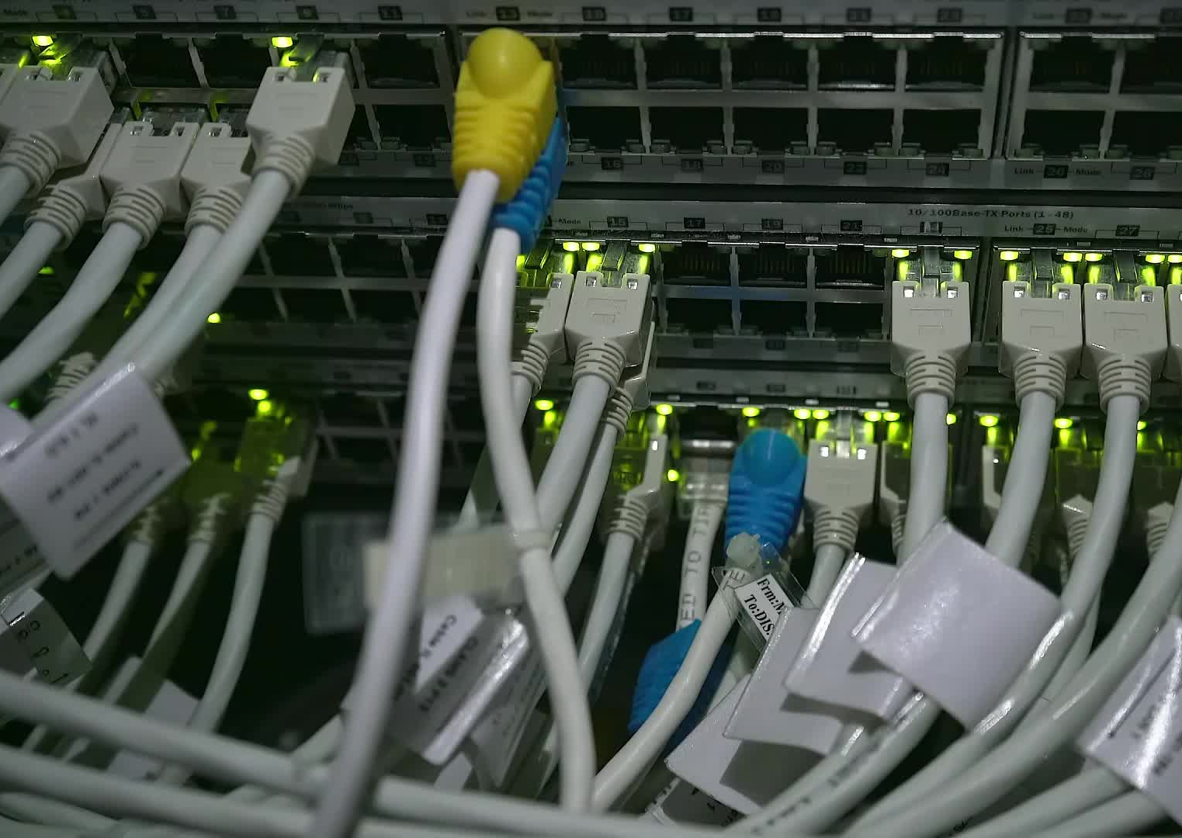
Network operators have a responsibility
To ensure a globally robust and secure routing infrastructure.
Network’s safety depends on a routing infrastructure that weeds out bad actors and accidental misconfigurations that wreak havoc on the Internet.
The more network operators work together, the fewer incidents there will be, and the less damage they can do.

Slide 12
CSIRTs can
help encourage their parent organizations or constituents to take routing security issues more seriously
raise awareness with governments of how routing security issues can affect critical infrastructure
encourage the adoption of routing security recommendations (such as NIST standards).

Slide 13
How can MANRS help improve the security and resilience of the DNS?
The DNS is reliant on the global routing system to deliver queries and return responses.
If routes are hijacked these may never arrive, whilst route leaks can allow these to be inspected or cause sufficient delays to cause queries to be dropped.
DDoS attacks are also a common attack vector, which anti-spoofing measures can mitigate.

Slide 14
Worth mentioning that MENA region is above the global average and comparable to the rest of the RIPE region (47% compared to 35%) in terms of RPKI implementation.
However, only 9.7% ASNs are currently performing Route Origin Validation, which is ultimately needed to benefit from RPKI.
Of course, less than half of ASNs providing cryptographic validation won’t help encourage this either.

Slide 15
What have we achieved
MANRS went from strength to strength over the past 12 months and now has over 900 participants across its four programs, along with 20 partners who help support our work.
We began issuing monthly reports to all participating network operators showing their state of routing security and conformance with the four MANRS Actions,
Supported the development of the Global Routing Intelligence Platform (GRIP) to provide an alternative source of route incident data, and in the past month launched the MANRS API that allows users to build their own reporting mechanism.
We saw RPKI adoption increase to 77% and ROV implementation to 10% amongst MANRS participants, while we observed an overall decline in routing incidents.

Slide 16
MANRS Observatory
is a tool that measures the level of networks’ compliance to MANRS, a key indicator of the state of routing security and the resiliency of the Internet.
The Observatory shows the degree of networks’ adherence to MANRS by tracking the number of routing incidents by region and country and monitoring metrics for MANRS actions.
The tool aggregates data from several trusted third-party sources into a user-friendly online dashboard.
This snapshot enables network operators to identify problematic areas to help them improve the security of their networks.

Slide 17
We’re happy to support the different communities improve routing security with MANRS tutorials and workshops
Securing Collaboration and Some Funds would help us a lot
1) Improving the business case for MANRS by implementing the MANRS Actions as industry standards under a recognized standards body.
2) Developing a certification program and quality mark with enhanced assurances to aid business decisions such as procurement (this is MANRS+)
3) Engaging government policymakers who are increasingly looking to introduce regulation with respect to the global routing system. Industry-led technical solutions are usually more effective than regulatory imposed ones.
4) Continuing the MANRS Mentors & Ambassadors program to extend our advocacy, technical capacity building and consultancy, and providing input to policymakers in different countries.
5) Developing the MANRS Observatory to offer a more customizable experience, including offering routing security data to MANRS participants for use with their own tools.
6) Developing the economic case for implementing MANRS by analyzing the costs of routing incidents.

Slide 18
Thank You

